Slide 1

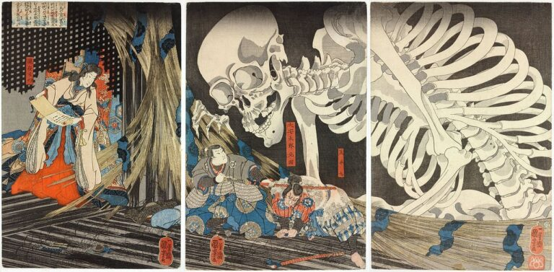
Night of the living Yōkai

Slide 2
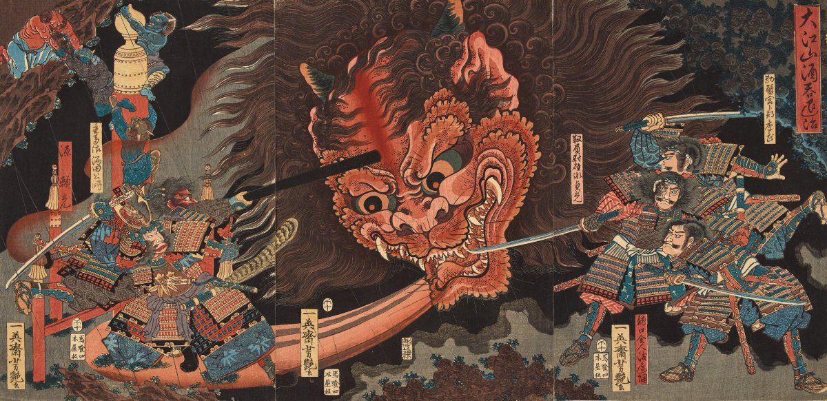
Core Ideas
Core Concept
Core Gameplay Loop
Wave-Based First-Person Combat.
Player starts at a house.
When meeting the local god, the waves of yokai spawns in the shrine yard and need to be defeated.
Interaction with good yokai for buffs.
Progression through unlockable weapons and abilities.
The player spawns into the game.
The player needs to equipped a katana from a small shrine.
After meeting the local god at the shrine, the first wave starts.
Each wave ends when all yokai are defeated.
As waves progress, the player will have a random interaction with a good yokai for buffs.
As the wave progress, the player will earn points based on how many enemies defeated and will be able to use them for unlocking abilities.
The game ends when the player is defeated or quits from the pause menu.

Slide 3
Task Done Checklist
Environment & World Systems
User Interface
Shrine Yard landscape design.
Rain/Weather system.
AI spawn system.
Round base system.
Score keeping system.
NPC interaction system.
Display player’s health.
Display wave counter.
Display Enemies Left/Enemies saved.
Display points.
Display abilities’ bar.
Display current weapon in hand.
Display secondary weapon.
Display main menu and pause menu.
Combat
Enemy AI (attacking, walking, targeting) behavior tree.
Player weapon swapping and attacking system: Gohei, and Kusanagi no Tsurugi (sword).
Level Up Buff system (health regen, speed, damage, and defense).
Ability system.
Damage & Health system.
Audio
Basic player’s audio.
Basic enemies’ audio.
Environment audio.
Basic combat audio.
Main Menu audio.

Slide 4

What I needed to research
Ai spawning and wave scaling logic.
Weapon swapping logic.
Creating custom animations.
Audio for player and ai movements.
Dialogue system.
What I needed outside Help On
Ability system.
Audio triggers when an animation notification triggers.

Slide 5
required Assets
Type | Name
Player | First Person Shrine Maiden model.
World | Shrines, trees, plants, landscape, rocks, rain, Oda Era houses and buildings, shrine decorations, environmental decals, river, underbrush, bushes.
Enemies | 4 different types of yokai.
Allies | 2 different types of yokai. (Plus, images for interactions)
weapon | 2 different types of weapons. (katana, Gohei)
Sounds | Running, attacking, enemies, environmental.
UI | Level-Up images, Ability Shrine images, Pause/Main Menu/Game Over/Options/Loading UI icons, and Lastly wounded player image.

Slide 6
Task Not Finished Check list
Environment & World Systems
User Interface
Interactive Day/Night cycle.
Need to do more performance boosting.
A working Options menu for main menu.
Combat
Audio
Include Boss Enemy AI.
Player Bow attacking system.
Player Jump.
Gohei weapon.

